Slide 1
BSTI 2.0 Final Financial Proposal
33 Digital Services | Progressive Service Rollout | Managed Maintenance
Date: 14 September, 2026
Presented by: Orange Business Development Ltd.
1

Slide 2
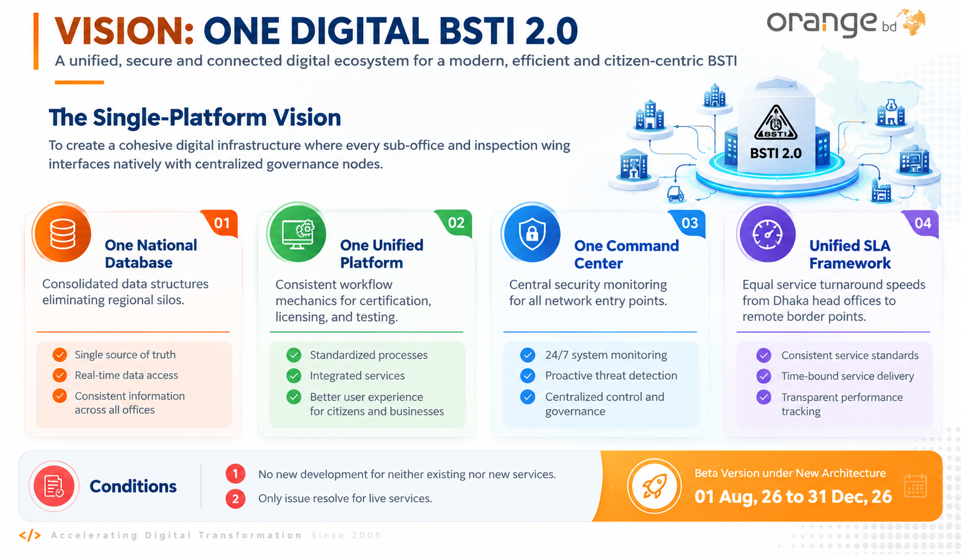

Slide 3
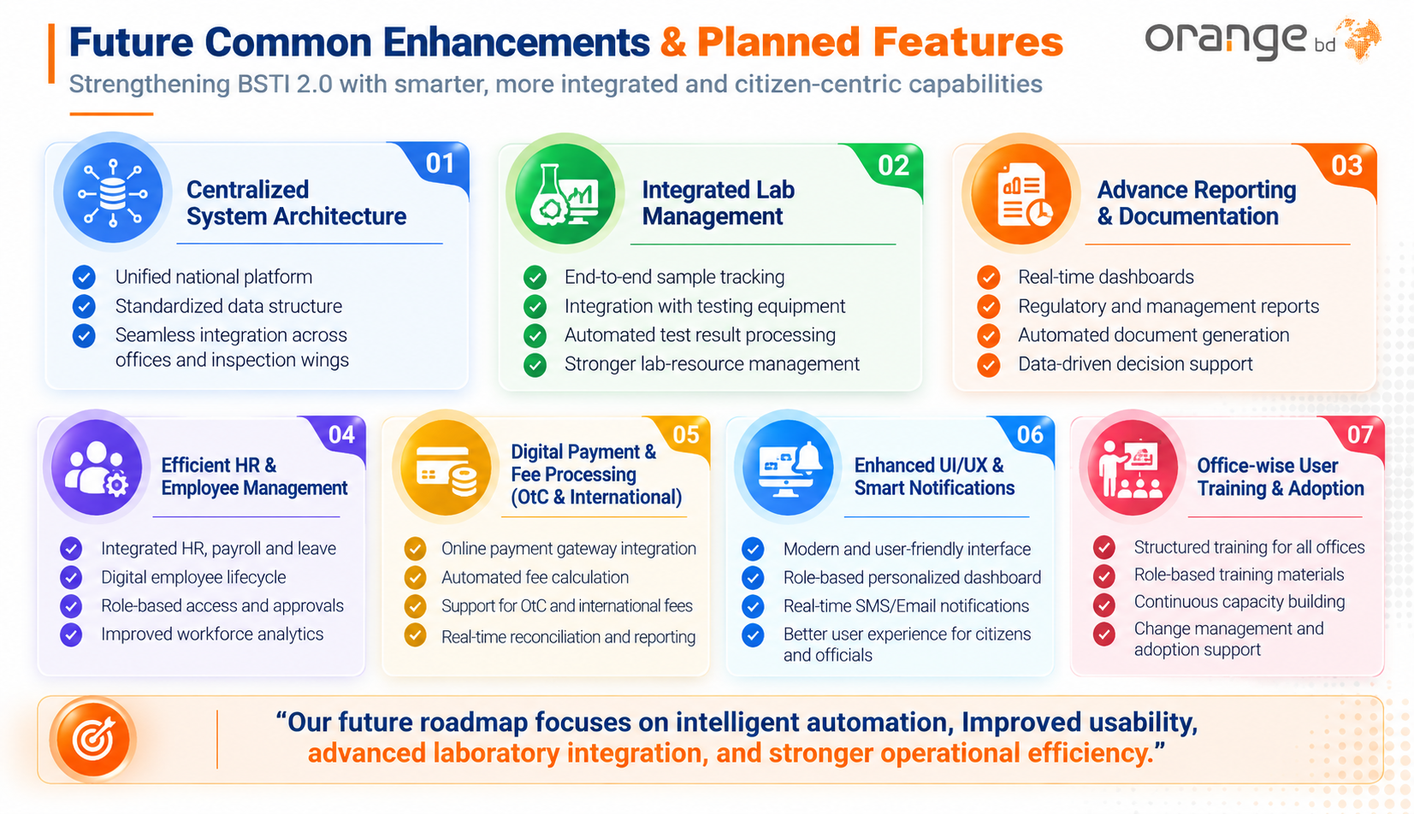

Slide 4
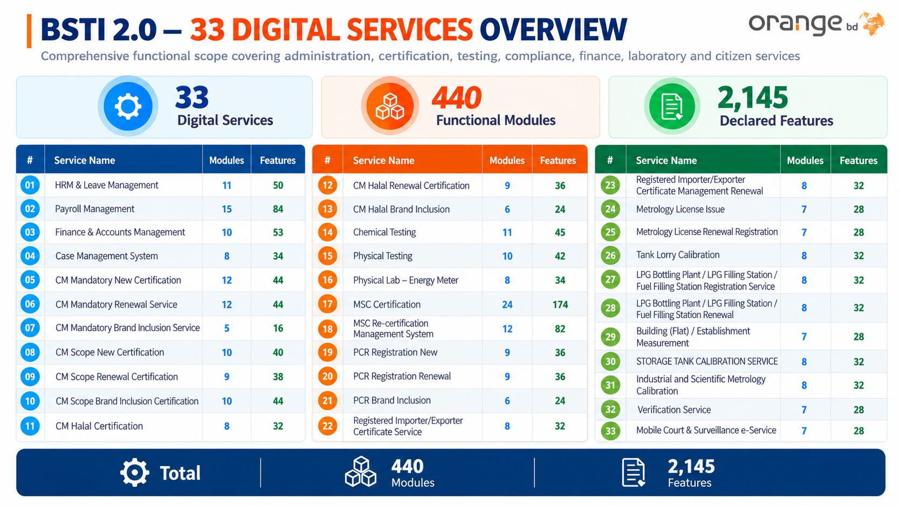
33
440
2,168
11
49
16
86
12
55
15
84
16
86
13
54
10
57
20
67
13
54
8
34
10
72
12
49
12
46
12
71
12
53
12
46
24
174
12
53
12
46
14
136
12
53
16
83
13
48
13
58
16
83
13
48
16
83
13
45
14
59
12
48
16
86
12
53
8
49
440
2,168

Slide 5
Financial Offer for BSTI
The final proposal presents a five-year service-based commercial structure.
TOTAL OFFER
ROLLOUT
MAINTENANCE
TOTAL SAVING
BDT 186,905,000
BDT 111,665,000
BDT 48,625,000
BDT 75,240,000
Five-year program
August 2026–December 2029
2030–2031
20.6% lower than benchmark
Commercial Comparison
Service-based offer
BDT 186,905,000
Staff-cost equivalent
BDT 235,530,000
Management Takeaway
•
Payment is linked to the number of live services rather than the full 33-service portfolio from day one.
•
The per-service rate reduces progressively and transitions to a lower maintenance rate after full rollout.
2
2

Slide 6
Rollout Payment Schedule August 2026 to December 2029
Quarter-wise commercial schedule from the final proposal
Period | Live Services | Monthly Rate / Service | Quarter / Period Payment
Aug–Dec 2026 | 5 | BDT 65,000 | BDT 1,625,000
Jan–Mar 2027 | 5 | BDT 180,000 | BDT 2,700,000
Apr–Jun 2027 | 8 | BDT 180,000 | BDT 4,320,000
Jul–Sep 2027 | 11 | BDT 180,000 | BDT 5,940,000
Oct–Dec 2027 | 14 | BDT 180,000 | BDT 7,560,000
Jan–Mar 2028 | 17 | BDT 155,000 | BDT 7,905,000
Apr–Jun 2028 | 20 | BDT 155,000 | BDT 9,300,000
Jul–Sep 2028 | 23 | BDT 155,000 | BDT 10,695,000
Oct–Dec 2028 | 26 | BDT 155,000 | BDT 12,090,000
Jan–Mar 2029 | 29 | BDT 130,000 | BDT 11,310,000
Apr–Jun 2029 | 32 | BDT 130,000 | BDT 12,480,000
Jul–Sep 2029 | 33 | BDT 130,000 | BDT 12,870,000
Oct–Dec 2029 | 33 | BDT 130,000 | BDT 12,870,000
ROLLOUT TOTAL
BDT 111,665,000
August 2026–December 2029
Annual cash profile
2026
BDT 1,625,000
2027
BDT 20,520,000
2028
BDT 39,990,000
2029
BDT 49,530,000
Peak rollout year: 2029
2
2

Slide 7
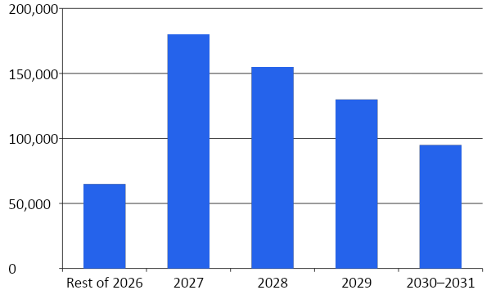
Progressive Per - Service Pricing
The monthly per-service rate reduces as the portfolio matures.
2027 STANDARD RATE
BDT 180,000
Per service / month
2029 RATE
BDT 130,000
27.8% discounted vs 2027
MAINTENANCE RATE
BDT 95,000
47.2% discounted vs 2027

Slide 8
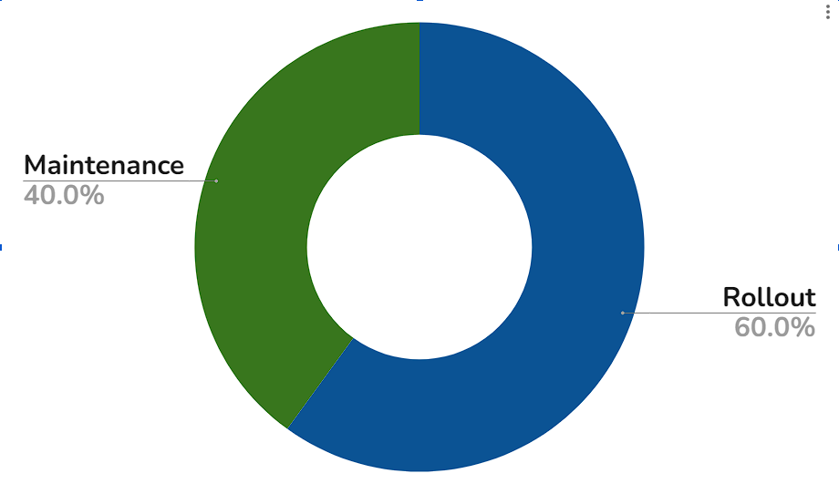
Five-Year Cost Composition
The total offer combines progressive rollout and two years of managed maintenance.
ROLLOUT
MAINTENANCE
BDT 111,665,000
BDT 75,240,000
59.7% of total offer
40.3% of total offer
Year-wise financial profile
Year | Payment
2026 | BDT 1,625,000
2027 | BDT 20,520,000
2028 | BDT 39,990,000
2029 | BDT 49,530,000
2030 | BDT 37,620,000
2031 | BDT 37,620,000

Slide 9
Cost Justification Benchmark Staff Remuneration
Reference cost model showing the resource requirement behind development, rollout and maintenance.
DEVELOPMENT / ROLLOUT
MAINTENANCE
TOTAL REFERENCE
MONTHLY EQUIVALENT
BDT 157,710,000
BDT 77,820,000
BDT 235,530,000
BDT 4,380,833
36-month reference basis
24-month reference basis
Staff-remuneration basis
Development / rollout
Development / rollout reference cost
Why the benchmark is higher
Engineering & Development
BDT 60.24 Mn
•
The reference team spans project management, architecture, analysis, engineering, database, DevOps, cybersecurity, UI/UX, QA, documentation, training, support, helpdesk and finance.
Management & Analysis
BDT 36.96 Mn
•
The staff model carries long person-month commitments across rollout and support.
Quality & Security
BDT 19.62 Mn
•
The service-based model converts that resource requirement into a portfolio-based commercial mechanism.
Operations & Support
BDT 40.89 Mn

Slide 10
Service-Based Offer vs Staff-Cost Benchmark
The recommended model retains the full 33-service target while reducing the reference cost.
Cost Component | Service-Based Offer | Staff-Cost Basis | BSTI Saving
Development / Rollout (03 Years) | BDT 111,665,000 | BDT 157,710,000 | BDT 46,045,000
Maintenance (02 Years) | BDT 75,240,000 | BDT 77,820,000 | BDT 2,580,000
TOTAL | BDT 186,905,000 | BDT 235,530,000 | BDT 48,625,000
DEVELOPMENT SAVING
MAINTENANCE SAVING
TOTAL COST ADVANTAGE
BDT 46,045,000
BDT 2,580,000
BDT 48,625,000
29.2% lower
3.3% lower
20.6% lower overall
The largest efficiency is achieved during the three-year progressive rollout phase.

Slide 11
Managed Service Benchmark
Organization | System | Vendor | Duration | Contract Value | Managed Service Scope Monthly
myGov | Government Service in One Address | Orangebd Ltd. | 52 Months | ৳12 Crore | ৳23.76 lac
Rural Development and Co-operatives Division | Integrated Digital Service Delivery Platform | Orangebd Ltd. | 3 Years | ৳11.44 Crore | ৳31.77 lac
Ministry of Land | Mutation System | Business Automation Ltd. | 4 Months | ৳1.37 Crore | ৳34.25 lac
Press Information Department | Media Management System | BMIT Solutions | 2 Years Support | ৳34.40 Crore | ৳1.43 crore
Jiban Bima Corporation | Bancassurance System | Synesis IT | 1 Year | ৳2.47 Crore | ৳20.58 Lac

Slide 12
33 Services to be Digitized
Service 19: PCR Registration New
Service 20: PCR Registration Renewal
Service 21: PCR Brand Inclusion
Service 22: Registered Importer/Exporter Certificate Service
Service 23: Registered Importer/Exporter Certificate Management Renewal
Service 24: Metrology License Issue
Service 25: Metrology License Renewal Registration
Service 26: Tank Lorry Calibration
Service 27: LPG Bottling Plant / LPG Filling Station / Fuel Filling Station Registration Service
Service 28: LPG Bottling Plant / LPG Filling Station / Fuel Filling Station Renewal
Service 29: Building (Flat) / Establishment Measurement
Service 30: Storage Tank Calibration Serice
Service 31: Industrial and Scientific Metrology Calibration
Service 32: Verification Service
Service 33:Mobile Court & Surveillance e-Service
Service 1: Hrm & Leave Management
Service 2: Payroll Management
Service 3: Finance & Account Management
Service 4: Case Management System
Service 5: CM Mandatory New Certification
Service 6: CM Mandatory Renewal Service
Service 7: CM Mandatory Brand Inclusion Service
Service 8: CM Scope New Certification
Service 9: CM Sope Renewal Certification
Service 10: CM Scope Brand Inclusion Certification
Service 11: CM Halal Certification
Service 12: CM Halal Renewal Certification
Service 13: CM Halal Brand Inclusion
Service 14: Chemical Testing
Service 15: Physical Testing
Service 16: Physical Lab – Energy Meter
Service 17: MSC Certification
Service 18: MSC Re-certification Management System

Slide 13
33 Service Analysis Summary

Slide 14










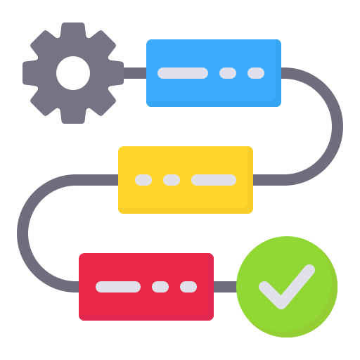

Service 01
HRM & LEAVE MANAGEMENT
Human Resource Administration • Employee Lifecycle • Leave Management
Service Profile
Domain
Human Resource Management
Service Type
Internal Enterprise Service
Primary Users
HR • Administrators • Employees • Management
Core Scope
Employee & Leave Administration
Modules
11
Features
49
Functional Coverage
Organization
Employee
Identification
Organogram
Office Management
Designation Management
Employee Profile
Employee Records
PDS
Digital Id Card
Unique Employee Id
QR Verification
Employee Administration
Workflow & Access
Leave Management
Office Assignment
Designation Assignment
Transfer & Posting
Release & joining
Employee Modification
Approval Workflow
User Roles & Permissions
User Management
Leave Policy
Leave Type
Leave Application
Leave Approval
Leave History
Module Catalogue
SL NO. | Modules | No. of Features | SL NO. | Modules | No. of Features
01 | Organogram | 4 | 07 | Users Module for Admin | 4
02 | Employee Management | 6 | 08 | Reset User Password for Admin | 1
03 | Employee Office Management | 5 | 09 | Director General | 1
04 | ID Card Management | 8 | 10 | Release and Assign | 4
05 | PDS (Personal Data Sheet) | 4 | 11 | Leave Management | 7
06 | Employee Modification with Dynamic Workflow | 5

Slide 15






Service 02
PAYROLL MANAGEMENT
Salary Processing • Payroll Administration • Employee Financial Benefits
Service Profile
Domain
Payroll & Employee Benefits
Service Type
Internal Enterprise Service
Primary Users
HR • Payroll • Finance • Employees
Core Scope
Salary, Benefits & Payroll Accounting
Modules
15
Features
84
Functional Coverage
Salary
Benefits
Tax & Accounting
Earnings & Deductions
Pay Scale
Salary Fixation
Salary Processing
Bonus
Bank Advice
Salary Certification
Payslip
Income Tax Statement
Journal Voucher
Payroll Accounts
Employee Finance
Control
Leave Output
Loan Management
GPF Management
Salary Month Lock
Payroll Controls
Salary Sheets
Certificates
Statements
Payslips
Module Catalogue
SL NO. | Modules | No. of Features | SL NO. | Modules | No. of Features
01 | Regular Salary – Earnings/Deductions | 6 | 09 | Income Tax Statement | 8
02 | Payroll Pay Scale | 2 | 10 | Journal Voucher | 9
03 | Salary Fixation | 5 | 11 | Payroll Accounts | 2
04 | Salary Process | 4 | 12 | Salary Month Lock | 1
05 | Bonus Process | 1 | 13 | Download Payslips | 1
06 | Bank Advice (Salary/Bonus) | 3 | 14 | Loan Management | 22
07 | Top Sheet (Salary/Bonus) | 2 | 15 | GPF | 12
08 | Salary Certification | 6

Slide 16






Service 03
FINANCE & ACCOUNTS MANAGEMENT
Budgeting • Revenue & Expenditure • Accounting • Financial Control
Service Profile
Domain
Finance & Accounts
Service Type
Internal Enterprise Service
Primary Users
Finance • Accounts • Authorized Management
Core Scope
End-to-End Financial Management
Modules
10
Features
57
Functional Coverage
Budget
Revenue & Expense
Accounting
Budget Creation & Allocation
Budget Distribution
Budget Control
Income Management
Expense Management
Collection Tracking
Ledger & Accounting
Voucher Management
Chart of Accounts
Payment & Payroll
Reporting
Control & Audit
Payment Gateway
Payroll Integration
Income Reports
Expense Reports
Budget Utilization
Ledger & Trial Balance
Role-Based Access
Approval
Audit Trail
Activity History
Module Catalogue
SL NO. | Modules | No. of Features | SL NO. | Modules | No. of Features
01 | Budget Management Module | 7 | 06 | Chart of Accounts | 5
02 | Income Management | 5 | 07 | Payment Gateway | 6
03 | Expense Management | 6 | 08 | Payroll Integration | 8
04 | Ledger & Accounting | 5 | 09 | Reporting System | 4
05 | Voucher Management Module | 5 | 10 | Role-Based Access Control & Audit | 6

Slide 17





Service 04
CASE MANAGEMENT SYSTEM
Case Registration • Investigation • Hearing • Decision & Closure
Service Profile
Domain
Regulatory / Legal Case Management
Service Type
Internal Enterprise Service
Primary Users
Case Officers • Authorized Officials • Management
Core Scope
End-to-End Case Lifecycle
Modules
8
Features
34
Functional Coverage
Case Intake
Investigation
Hearing & Decision
Case Registration
Case Review
Assignment
Investigation Management
Evidence & Findings
Hearing & Court
Approval Management
Penalty
Closure
Reporting
Fine Calculation
Penalty Recording
Payment Verification
Case Disposal
Disposal Report
Archive
Notifications
Case Reports
Dashboard
Module Catalogue
SL NO. | Modules | No. of Features | SL NO. | Modules | No. of Features
01 | Case Registration | 5 | 05 | Approval Management | 4
02 | Case Review & Assignment | 4 | 06 | Fine & Penalty Management | 4
03 | Investigation Management | 4 | 07 | Case Closure | 4
04 | Hearing & Court Management | 4 | 08 | Notification & Reporting | 5

Slide 18





Service 05
CM MANDATORY NEW CERTIFICATION
Certification Application • Inspection • Verification • CM Certification
Service Profile
Domain
Certification of Marks (CM)
Service Type
Regulatory / Certification Service
Primary Users
Applicants • Reviewers • Inspectors • AD • DD • Director • System Admin
Core Scope
Mandatory CM Certification
Modules
12
Features
46
Functional Coverage
Application
Review
Inspection
Online Application
Document Upload
Application Fee
Application ID
Application Review
Shortfall Identification
Correction & Resubmission
Inspector Assignment
Inspection Scheduling
Inspection & Report
Verification
Certification
Control
Ad/Dd Verification
Director Decision
Approval / Rejection
Registration Completion
Cm Certificate Generation
Download
Re-Inspection
Notifications
User & Role Management
Module Catalogue
SL NO. | Modules | No. of Features | SL NO. | Modules | No. of Features
01 | Application Submission | 4 | 07 | Director Decision | 3
02 | Application Review & Shortfall Management | 5 | 08 | Certification Complete | 3
03 | Payment Processing | 4 | 09 | Rejection Management | 3
04 | Inspection Setup | 3 | 10 | Notification Management | 3
05 | Inspection & Report | 5 | 11 | Re-Inspection Management | 3
06 | Verification Module (AD/DD) | 3 | 12 | User & Role Management | 7

Slide 19
Service 06
CM MANDATORY RENEWAL SERVICE
Renewal Application • Inspection • Verification • CM Certification
Service Profile
Domain
Certification of Marks (CM)
Service Type
Regulatory / Certification Service
Primary Users
Applicants • Reviewers • Inspectors • AD • DD • Director • System Admin
Core Scope
Mandatory CM Renewal
Modules
12
Features
46
Functional Coverage
Application
Review
Inspection
Online Application
Document Upload
Application Fee
Application Id
Application Review
Shortfall Identification
Correction & Resubmission
Inspector Assignment
Inspection Scheduling
Inspection & Report
Verification
Certification
Control
Ad/Dd Verification
Director Decision
Approval / Rejection
Registration Completion
Cm Certificate Generation
Download
Re-Inspection
Notifications
User & Role Management
Module Catalogue
SL NO. | Modules | No. of Features | SL NO. | Modules | No. of Features
01 | Application Submission | 4 | 07 | Director Decision | 3
02 | Application Review & Shortfall Management | 5 | 08 | Certification Complete | 3
03 | Payment Processing | 4 | 09 | Rejection Management | 3
04 | Inspection Setup | 3 | 10 | Notification Management | 3
05 | Inspection & Report | 5 | 11 | Re-Inspection Management | 3
06 | Verification Module (AD/DD) | 3 | 12 | User & Role Management | 7

Slide 20
Service 07
CM MANDATORY BRAND INCLUSION
Brand Inclusion • Application Review • Inspection • Certification
Service Profile
Domain
Certification of Marks (CM)
Service Type
Regulatory / Certification Service
Primary Users
Applicants • Reviewers • Inspectors • AD • DD • Director • System Admin
Core Scope
Mandatory Brand Inclusion
Modules
12
Features
46
Functional Coverage
Application
Review
Inspection
Online Application
Document Upload
Application Fee
Application ID
Application Review
Shortfall Identification
Correction & Resubmission
Inspector Assignment
Inspection Scheduling
Inspection & Report
Verification
Certification
Control
Ad/Dd Verification
Director Decision
Approval / Rejection
Registration Completion
Cm Certificate Generation
Download
Re-Inspection
Notifications
User & Role Management
Module Catalogue
SL NO. | Modules | No. of Features | SL NO. | Modules | No. of Features
01 | Application Submission | 4 | 07 | Director Decision | 3
02 | Application Review & Shortfall Management | 5 | 08 | Certification Complete | 3
03 | Payment Processing | 4 | 09 | Rejection Management | 3
04 | Inspection Setup | 3 | 10 | Notification Management | 3
05 | Inspection & Report | 5 | 11 | Re-Inspection Management | 3
06 | Verification Module (AD/DD) | 3 | 12 | User & Role Management | 7

Slide 21



Service 08
CM SCOPE NEW CERTIFICATION
Scope Product Certification • Inspection • Laboratory Testing • Licensing
Service Profile
Domain
Certification of Marks (CM)
Service Type
Regulatory / Certification Service
Primary Users
Applicants • Reviewers • Inspectors • AD • DD • Director • Certification Committee
Core Scope
Scope Product Certification
Modules
16
Features
83
Functional Coverage
Application
Review
Inspection & Testing
License Application
Initial Questionnaire
Fee Payment
Application Tracking
Multi-Level Review
Shortfall Management
Customer Resubmission
Inspection Planning
Primary Inspection
Formal Inspection
Laboratory Testing
Evaluation
Compliance
Licensing & Control
Technical Evaluation
Verification & Approval
Certification Committee
Conditional Compliance
Re-Inspection
Corrective Evidence
Payment
License Management
Notifications
Workflow
Documents
Module Catalogue
SL NO. | Modules | No. of Features | SL NO. | Modules | No. of Features
01 | Application Submission | 5 | 09 | Certification Committee | 5
02 | Application Review & Shortfall Management | 8 | 10 | Conditional Compliance | 5
03 | Inspection Planning | 4 | 11 | Payment Processing | 5
04 | Primary Inspection | 5 | 12 | License Management | 5
05 | Formal Inspection | 5 | 13 | Refusal & Rejection Management | 4
06 | Laboratory Testing | 5 | 14 | Notification | 6
07 | Technical Evaluation | 4 | 15 | Workflow & Task Management | 5
08 | Verification & Approval | 5 | 16 | Document Management | 7

Slide 22
Service 09
CM SCOPE RENEWAL CERTIFICATION
Human Resource Administration • Employee Lifecycle • Leave Management
Service Profile
Domain
Certification of Marks (CM)
Service Type
Regulatory / Certification Service
Primary Users
Applicants • Reviewers • Inspectors • AD • DD • Director • Certification Committee
Core Scope
Scope Product Renewal Certification
Modules
16
Features
83
Functional Coverage
Application
Review
Inspection & Testing
License Application
Initial Questionnaire
Fee Payment
Application Tracking
Multi-Level Review
Shortfall Management
Customer Resubmission
Inspection Planning
Primary Inspection
Formal Inspection
Laboratory Testing
Evaluation
Compliance
Licensing & Control
Technical Evaluation
Verification & Approval
Certification Committee
Conditional Compliance
Re-Inspection
Corrective Evidence
Payment
License Management
Notifications
Workflow
Documents
Module Catalogue
SL NO. | Modules | No. of Features | SL NO. | Modules | No. of Features
01 | Application Submission | 5 | 09 | Certification Committee | 5
02 | Application Review & Shortfall Management | 8 | 10 | Conditional Compliance | 5
03 | Inspection Planning | 4 | 11 | Payment Processing | 5
04 | Primary Inspection | 5 | 12 | License Management | 5
05 | Formal Inspection | 5 | 13 | Refusal & Rejection Management | 4
06 | Laboratory Testing | 5 | 14 | Notification | 6
07 | Technical Evaluation | 4 | 15 | Workflow & Task Management | 5
08 | Verification & Approval | 5 | 16 | Document Management | 7

Slide 23
Service 10
CM SCOPE BRAND INCLUSION CERTIFICATION
Brand Inclusion • Inspection • Laboratory Testing • Certification
Service Profile
Domain
Certification of Marks (CM)
Service Type
Regulatory / Certification Service
Primary Users
Applicants • Reviewers • Inspectors • AD • DD • Director • Certification Committee
Core Scope
Scope Brand Inclusion Certification
Modules
16
Features
83
Functional Coverage
Application
Review
Inspection & Testing
License Application
Initial Questionnaire
Fee Payment
Application Tracking
Multi-Level Review
Shortfall Management
Customer Resubmission
Inspection Planning
Primary Inspection
Formal Inspection
Laboratory Testing
Evaluation
Compliance
Licensing & Control
Technical Evaluation
Verification & Approval
Certification Committee
Conditional Compliance
Re-Inspection
Corrective Evidence
Payment
License Management
Notifications
Workflow
Documents
Module Catalogue
SL NO. | Modules | No. of Features | SL NO. | Modules | No. of Features
01 | Application Submission | 5 | 09 | Certification Committee | 5
02 | Application Review & Shortfall Management | 8 | 10 | Conditional Compliance | 5
03 | Inspection Planning | 4 | 11 | Payment Processing | 5
04 | Primary Inspection | 5 | 12 | License Management | 5
05 | Formal Inspection | 5 | 13 | Refusal & Rejection Management | 4
06 | Laboratory Testing | 5 | 14 | Notification | 6
07 | Technical Evaluation | 4 | 15 | Workflow & Task Management | 5
08 | Verification & Approval | 5 | 16 | Document Management | 7

Slide 24
Service 11
CM HALAL CERTIFICATION
Halal Certification • Audit • Laboratory Testing • Certificate Management
Service Profile
Domain
Certification of Marks (CM)
Service Type
Regulatory / Certification Service
Primary Users
Applicants • AD • DD • Director • Audit Team • Certification Committee
Core Scope
Halal Certification Lifecycle
Modules
16
Features
86
Functional Coverage
Application & Review
Employee
Identification
Certificate Application
Shortfall Management
Customer Resubmission
Stage-1 Audit
Audit Observation & Compliance
Stage-2 Audit & Sample Management
Sample Management
Laboratory Testing
Test Reports
Employee Administration
Workflow & Access
Leave Management
Technical Evaluation
Verification & Approval
Certification Committee
Conditional Compliance
Payment
Certificate / License
Refusal & Rejection
Notification
Workflow
Document Management
Module Catalogue
SL NO. | Modules | No. of Features | SL NO. | Modules | No. of Features
01 | Certificate Application | 4 | 09 | Certification Committee | 5
02 | Application Review & Shortfall Management | 8 | 10 | Conditional Compliance | 5
03 | Stage-1 Audit Management | 6 | 11 | Payment Processing | 5
04 | Audit Observation & Compliance | 4 | 12 | Certificate / License Management | 5
05 | Stage-2 Audit & Sample Management | 5 | 13 | Refusal & Rejection Management | 5
06 | Laboratory Testing | 5 | 14 | Notification | 7
07 | Technical Evaluation | 4 | 15 | Workflow & Task Management | 6
08 | Verification & Approval | 5 | 16 | Document Management | 7

Slide 25




Service 12
CM HALAL RENEWAL CERTIFICATION
Halal Certification • Audit • Laboratory Testing • Certificate Management
Service Profile
Domain
Certification of Marks (CM)
Service Type
Regulatory / Certification Service
Primary Users
Applicants • AD • DD • Director • Audit Team • Certification Committee
Core Scope
Halal Certification Lifecycle
Modules
16
Features
86
Functional Coverage
Application & Review
Audit
Laboratory
Certificate Application
Shortfall Management
Customer Resubmission
Stage-1 Audit
Audit Observation & Compliance
Stage-2 Audit & Sample Management
Sample Management
Laboratory Testing
Test Reports
Evaluation & Approval
Compliance & Certificate
Control & Records
Technical Evaluation
Verification & Approval
Certification Committee
Conditional Compliance
Payment
Certificate / License
Refusal & Rejection
Notification
Workflow
Document Management
Module Catalogue
SL NO. | Modules | No. of Features | SL NO. | Modules | No. of Features
01 | Certificate Application | 4 | 09 | Certification Committee | 5
02 | Application Review & Shortfall Management | 8 | 10 | Conditional Compliance | 5
03 | Stage-1 Audit Management | 6 | 11 | Payment Processing | 5
04 | Audit Observation & Compliance | 4 | 12 | Certificate / License Management | 5
05 | Stage-2 Audit & Sample Management | 5 | 13 | Refusal & Rejection Management | 5
06 | Laboratory Testing | 5 | 14 | Notification | 7
07 | Technical Evaluation | 4 | 15 | Workflow & Task Management | 6
08 | Verification & Approval | 5 | 16 | Document Management | 7

Slide 26
Service 13
CM HALAL BRAND INCLUSION
Halal Certification • Audit • Laboratory Testing • Certificate Management
Service Profile
Domain
Certification of Marks (CM)
Service Type
Regulatory / Certification Service
Primary Users
Applicants • AD • DD • Director • Audit Team • Certification Committee
Core Scope
Halal Certification Lifecycle
Modules
16
Features
86
Functional Coverage
Application & Review
Audit
Laboratory
Certificate Application
Shortfall Management
Customer Resubmission
Stage-1 Audit
Audit Observation & Compliance
Stage-2 Audit & Sample Management
Sample Management
Laboratory Testing
Test Reports
Evaluation & Approval
Compliance & Certificate
Control & Records
Technical Evaluation
Verification & Approval
Certification Committee
Conditional Compliance
Payment
Certificate / License
Refusal & Rejection
Notification
Workflow
Document Management
Module Catalogue
SL NO. | Modules | No. of Features | SL NO. | Modules | No. of Features
01 | Certificate Application | 4 | 09 | Certification Committee | 5
02 | Application Review & Shortfall Management | 8 | 10 | Conditional Compliance | 5
03 | Stage-1 Audit Management | 6 | 11 | Payment Processing | 5
04 | Audit Observation & Compliance | 4 | 12 | Certificate / License Management | 5
05 | Stage-2 Audit & Sample Management | 5 | 13 | Refusal & Rejection Management | 5
06 | Laboratory Testing | 5 | 14 | Notification | 7
07 | Technical Evaluation | 4 | 15 | Workflow & Task Management | 6
08 | Verification & Approval | 5 | 16 | Document Management | 7

Slide 27


Service 14
CHEMICAL TESTING
Sample Testing • Verification • Re-Test • Report Delivery
Service Profile
Domain
Chemical Wing Testing
Service Type
Laboratory Testing Service
Primary Users
Applicant • OSS • Director (Chemical) • DD • AD • Examiner / Senior Examiner
Core Scope
Laboratory Testing Lifecycle
Modules
20
Features
67
Functional Coverage
Sample Management
Verification
Reporting
Sample Tracking
Resample Management
Sample Security
Multi-Level Verification
Correction & Return
Re-Test Management
Report Generation
Report Delivery
Remarks & Comment
Workflow
Security & Access
Monitoring
Workflow Engine
Task Management
Regional Office Workflow
Access Control
Data Security
Multiple Role Management
Dashboard
Audit & Activity Log
Search
Localization
Module Catalogue
SL NO. | Modules | No. of Features | SL NO. | Modules | No. of Features
01 | Sample Tracking | 4 | 11 | Dashboard | 3
02 | Resample Management | 4 | 12 | Audit & Activity Log | 4
03 | Sample Security | 3 | 13 | WorkflowEngine | 3
04 | Multi-Level Verification | 4 | 14 | Search | 4
05 | Correction & Return | 4 | 15 | Access Control | 3
06 | Re-Test Management | 3 | 16 | Localization | 2
07 | Notification | 4 | 17 | Data Security | 3
08 | Remarks & Comment | 4 | 18 | Report Delivery | 3
09 | Report Generation | 3 | 19 | Multiple Role Management | 3
10 | Task Management | 3 | 20 | Regional Office Workflow | 3

Slide 28

Service 15
PHYSICAL TESTING
Laboratory Testing • Sample Management • Test Results • Report Delivery
Service Profile
Domain
Physical Wing Testing
Service Type
Laboratory Testing Service
Primary Users
Applicant • OSS • Director • DD • AD • Examiner / Senior Examiner
Core Scope
Physical Testing & Laboratory Management
Modules
10
Features
72
Functional Coverage
Application
Samples
Testing
Application Management
User & Role Management
Sample Management
Energy Meter Management
Parameter Management
Test & Result Management
Product & Laboratory Management
Reporting
Workflow
Control
Report Management
Notification Management
Workflow Management
Role-Based Processing
User & Role Management
Testing Records
Activity Tracking
Module Catalogue
SL NO. | Modules | No. of Features | SL NO. | Modules | No. of Features
01 | User & Role Management | 9 | 06 | Test & Result Management | 7
02 | Application Management | 7 | 07 | Report Management | 9
03 | Sample Management | 6 | 08 | Notification Management | 5
04 | Workflow Management | 7 | 09 | Energy Meter Management | 10
05 | Parameter Management | 6 | 10 | Product & Laboratory Management | 6

Slide 29
Service 16
PHYSICAL LAB- ENERGY METER
Energy Meter Testing • Sample Collection • Result Verification • Test Report
Service Profile
Domain
Physical Laboratory / Energy Meter
Service Type
Laboratory Testing Service
Primary Users
Applicant • OSS • Director • DD • AD / Senior Examiner • Examiner
Core Scope
Energy Meter Testing Lifecycle
Modules
12
Features
71
Functional Coverage
Application & Shortfall
Sample Collection
Testing
Application Management
Shortfall Management
User & Role Management
Sample Collection Management
Energy Meter Information
Energy Meter Testing
Test Result Entry
Retest Management
Verification
Reporting
Tracking & Audit
Result Verification & Approval
Workflow Management
Test Report Management
Notification Management
Application Tracking
Sample Tracking
Test Result Tracking
User Activity
Module Catalogue
SL NO. | Modules | No. of Features | SL NO. | Modules | No. of Features
01 | User & Role Management | 7 | 07 | Workflow Management | 6
02 | Application Management | 7 | 08 | Retest Management | 5
03 | Shortfall Management | 5 | 09 | Test Report Management | 6
04 | Sample Collection Management | 7 | 10 | Notification Management | 5
05 | Energy Meter Testing Management | 6 | 11 | Energy Meter Information Management | 5
06 | Result Verification & Approval | 7 | 12 | Tracking & Audit Management | 5

Slide 30





Service 17
MSC CERTIFICATION
Management System Certification • Audit • Corrective Action • Certification
Service Profile
Domain
Management System Certification (MSC)
Service Type
Certification / Audit Service
Primary Users
Applicant • DD (DC) • DCO • IAO • DD (IA) • Head of MSC • Audit Team • DG • Certification Committee
Core Scope
Complete MSC Certification Lifecycle
Modules
24
Features
174
Functional Coverage
Application
Agreement & Planning
Audit & Corrective Action
Msc Application
Payment & Documents
Adequacy Audit
Acceptance & Agreement
Man-Day Calculation
Audit Scheduling
Stage-1 Audit
Corrective Action
Stage-2 Audit
Findings Closure
Certification
Certificate & Follow-Up
Digital Control
Technical Proposal
Billing
Certification Committee
Minutes
Certificate Generation
Rejection / Rework
Follow-Up Audit
Workflow
Notifications
Tracking
Dashboard
• Audit Trail
• Qr Verification
Module Catalogue
SL NO. | Modules | No. of Features | SL NO. | Modules | No. of Features
01 | MSC Application Management | 6 | 13 | Certification Committee Meeting Management Module | 8
02 | Application Payment and Document Management Module | 6 | 14 | Certification Committee Minutes Management Module | 6
03 | Application Review and Adequacy Audit Module | 8 | 15 | MSC Certificate Generation and Approval Module | 7
04 | Acceptance and Agreement Management Module | 8 | 16 | Rejection, Rework and Follow-Up Audit Module | 6
05 | Man-Day Calculation and Audit Scheduling Module | 7 | 17 | Workflow and Approval Management Module | 6
06 | Stage-1 Audit Management Module | 8 | 18 | Notification and Communication Management Module | 10
07 | Corrective Action Management Module | 9 | 19 | Application and Workflow Tracking Module | 7
08 | Stage-2 Audit Notice and Scheduling Module | 8 | 20 | MSC Reports and Dashboard Module | 9
09 | Stage-2 Audit Management Module | 8 | 21 | Audit Trail and Activity Log Module | 7
10 | Stage-2 Corrective Action and Findings Closure Module | 8 | 22 | Role-Based User and Access Management Module | 5
11 | Initial Certification Proposal Management Module | 6 | 23 | External Integration Management Module | 7
12 | Audit and Certification Billing Module | 9 | 24 | Certificate Verification and QR Code | 5

Slide 31



Service 18
MSC RE-CERTIFICATION MANAGEMENT SYSTEM
Re-certification • Audit • Corrective Action • Certification
Service Profile
Domain
Management System Certification (MSC)
Service Type
Certification / Audit Service
Primary Users
Applicant • DD (DC) • DCO • DD (IA) • Head of MSC • Audit Team • Certification Committee
Core Scope
Complete MSC Re-certification Lifecycle
Modules
14
Features
136
Functional Coverage
Application
Audit Planning
Audit & Findings
Re-Certification Application
Application Review
Agreement Management
Man-Day Calculation
Auditor Assignment
Audit Scheduling
Re-Certification Audit
Audit Findings
Corrective Action
Improvement Notice
Technical Review
Certification
Control
Technical Review
Certification Proposal
Committee Management
Payment Processing
Certificate & Document Management
Rejection
Workflow
Notifications
Tracking
Audit Trail
Module Catalogue
SL NO. | Modules | No. of Features | SL NO. | Modules | No. of Features
01 | Re-certification Application | 7 | 08 | Certification Committee Management | 9
02 | Application Review & Agreement Management | 10 | 09 | Payment Processing | 7
03 | Audit Planning & Scheduling | 10 | 10 | Certificate & Document Management | 7
04 | Re-certification Audit Management | 9 | 11 | Rejection Management | 4
05 | Audit Findings & Corrective Action Management | 10 | 12 | Workflow & Task Management Module | 7
06 | Improvement Notice Management | 7 | 13 | Notification Module | 10
07 | Technical Review & Proposal Management | 6 | 14 | Document Management Module | 10

Slide 32




Service 19
PCR REGISTRATION NEW
PCR Registration • Inspection • Approval • Certificate
Service Profile
Domain
PCR Registration
Service Type
Registration / Certification Service
Primary Users
Applicants • Reviewers • Inspectors • AD • DD • Director • System Admin
Core Scope
New PCR Registration
Modules
13
Features
48
Functional Coverage
Application
Review
Inspection
Application Submission
Document Upload
Application Fee
Application Review
Shortfall Management
Resubmission
Inspection Setup
Inspection & Report
Re-Inspection
Approval
Registration
Control
Ad/DD Verification
Approval Management
Director Decision
Registration Complete
Certificate Generation
Download
Notifications
User & Role Management
Regional Office Workflow
Module Catalogue
SL NO. | Modules | No. of Features | SL NO. | Modules | No. of Features
01 | Application Submission | 4 | 08 | Registration Complete | 3
02 | Application Review & Shortfall Management | 5 | 09 | Rejection Management | 2
03 | Payment Processing | 4 | 10 | Notification Management | 3
04 | Inspection Setup | 3 | 11 | Re-Inspection Management | 3
05 | Inspection & Report | 5 | 12 | User & Role Management | 7
06 | Verification Module (AD/DD) | 3 | 13 | Regional Office Workflow | 3
07 | Approval Management | 3

Slide 33
Service 20
PCR REGISTRATION RENEWAL
PCR Renewal • Inspection • Approval • Certificate Renewal
Service Profile
Domain
PCR Registration
Service Type
Registration / Certification Service
Primary Users
Applicants • Reviewers • Inspectors • AD • DD • Director • System Admin
Core Scope
PCR Registration Renewal
Modules
13
Features
48
Functional Coverage
Application
Review
Inspection
Application Submission
Document Upload
Application Fee
Application Review
Shortfall Management
Resubmission
Inspection Setup
Inspection & Report
Re-Inspection
Approval
Registration
Control
Ad/DD Verification
Approval Management
Director Decision
Registration Complete
Certificate Generation
Download
Notifications
User & Role Management
Regional Office Workflow
Module Catalogue
SL NO. | Modules | No. of Features | SL NO. | Modules | No. of Features
01 | Application Submission | 4 | 08 | Registration Complete | 3
02 | Application Review & Shortfall Management | 5 | 09 | Rejection Management | 2
03 | Payment Processing | 4 | 10 | Notification Management | 3
04 | Inspection Setup | 3 | 11 | Re-Inspection Management | 3
05 | Inspection & Report | 5 | 12 | User & Role Management | 7
06 | Verification Module (AD/DD) | 3 | 13 | Regional Office Workflow | 3
07 | Approval Management | 3

Slide 34
Service 21
PCR BRAND INCLUSION
Brand Inclusion • Inspection • Approval • PCR Certificate
Service Profile
Domain
PCR Registration
Service Type
Registration / Certification Service
Primary Users
Applicants • Reviewers • Inspectors • AD • DD • Director • System Admin
Core Scope
PCR Brand Inclusion
Modules
13
Features
45
Functional Coverage
Application
Review
Inspection
Application Submission
Document Upload
Application Fee
Application Review
Shortfall Management
Resubmission
Inspection Setup
Inspection & Report
Re-Inspection
Approval
Registration
Control
Ad/DD Verification
Approval Management
Director Decision
Registration Complete
Certificate Generation
Download
Notifications
User & Role Management
Regional Office Workflow
Module Catalogue
SL NO. | Modules | No. of Features | SL NO. | Modules | No. of Features
01 | Application Submission | 3 | 08 | Registration Complete | 1
02 | Application Review & Shortfall Management | 5 | 09 | Rejection Management | 2
03 | Payment Processing | 4 | 10 | Notification Management | 3
04 | Inspection Setup | 3 | 11 | Re-Inspection Management | 3
05 | Inspection & Report | 5 | 12 | User & Role Management | 7
06 | Verification Module (AD/DD) | 3 | 13 | Regional Office Workflow | 3
07 | Approval Management | 3

Slide 35


Service 22
REGISTERED IMPORTER/EXPORTER CERTIFICATE SERVICE
Importer/Exporter Registration • Inspection • Certification
Service Profile
Domain
Importer / Exporter Registration
Service Type
Registration / Certification Service
Primary Users
Applicants • Director • DD • AD • Inspectors • System Admin
Core Scope
Registered Importer / Exporter Certification
Modules
12
Features
53
Functional Coverage
Application
Review & Shortfall
Inspection
Application Submission
Document Upload
Registration Fee
Director Review
Ad Review
Shortfall
Resubmission
Scheduling
Inspection
Report Verification
Re-Inspection
Certification
Communication
Records
Payment Processing
Certificate Management
Rejection
Notifications
Workflow & Task Management
Document Management
Certificate Repository
Audit Records
Module Catalogue
SL NO. | Modules | No. of Features | SL NO. | Modules | No. of Features
01 | Application Submission | 4 | 07 | Payment Processing | 4
02 | Application Review & Shortfall Management | 6 | 08 | Certificate Management | 5
03 | Inspection Scheduling | 4 | 09 | Rejection Management | 3
04 | Inspection Management | 4 | 10 | Notification | 6
05 | Inspection Report Verification | 4 | 11 | Workflow & Task Management | 5
06 | Re-inspection Management | 4 | 12 | Document Management | 4

Slide 36

Service 23
REGISTERED IMPORTER/EXPORTER CERTIFICATE MANAGEMENT RENEWAL
Renewal / Re-Certification • Inspection • Certificate
Service Profile
Domain
Importer / Exporter Registration
Service Type
Renewal / Certification Service
Primary Users
Applicants • Director • DD • AD • Inspectors • System Admin
Core Scope
Registered Importer / Exporter Renewal
Modules
12
Features
55
Functional Coverage
Application
Review & Shortfall
Inspection
Application Submission
Document Upload
Registration Fee
Director Review
Ad Review
Shortfall
Resubmission
Scheduling
Inspection
Report Verification
Re-Inspection
Certification
Communication
Records
Payment Processing
Certificate Management
Rejection
Notifications
Workflow & Task Management
Document Management
Certificate Repository
Audit Records
Module Catalogue
SL NO. | Modules | No. of Features | SL NO. | Modules | No. of Features
01 | Re-Application Submission | 6 | 07 | Payment Processing | 4
02 | Application Review & Shortfall Management | 6 | 08 | Certificate Management | 5
03 | Inspection Scheduling | 4 | 09 | Rejection Management | 3
04 | Inspection Management | 4 | 10 | Notification Management | 6
05 | Inspection Report Verification | 4 | 11 | Workflow & Task Management | 5
06 | Re-inspection Management | 4 | 12 | Document Management | 4

Slide 37

Service 24
METROLOGY LICENSE ISSUE
License Application • Inspection • Verification • Licensing
Service Profile
Domain
Metrology Licensing
Service Type
Licensing / Calibration Service
Primary Users
Applicants • Director • DD • AD • Inspectors • System Admin
Core Scope
Metrology License Lifecycle
Modules
13
Features
54
Functional Coverage
Application
Inspection
Verification
Application Submission
Category-Wise Application
Shortfall Management
Inspection Scheduling
Inspection Management
Re-Inspection
Ad Verification
Dd Approval
Director Approval
Licensing
Communication
Records
Payment Processing
License Generation
License Download
Notification
Status Tracking
Workflow
Document Management
License Repository
Rejection Records
Module Catalogue
SL NO. | Modules | No. of Features | SL NO. | Modules | No. of Features
01 | Application Submission | 4 | 08 | Payment Processing | 4
02 | Application Review & Assignment | 4 | 09 | License Management | 4
03 | Shortfall Management | 5 | 10 | Rejection Management | 3
04 | Inspection Scheduling | 4 | 11 | Notification | 6
05 | Inspection Management | 3 | 12 | Workflow & Task Management | 5
06 | Inspection Verification & Approval | 4 | 13 | Document Management | 4
07 | Re-inspection Management | 4

Slide 38
Service 25
METROLOGY LICENSE RENEWAL REGISTRATION
License Renewal • Inspection • Verification • Licensing
Service Profile
Domain
Metrology Licensing
Service Type
Licensing / Calibration Service
Primary Users
Applicants • Director • DD • AD • Inspectors • System Admin
Core Scope
Metrology License Lifecycle
Modules
13
Features
54
Functional Coverage
Application
Inspection
Verification
Application Submission
Category-Wise Application
Shortfall Management
Inspection Scheduling
Inspection Management
Re-Inspection
Ad Verification
Dd Approval
Director Approval
Licensing
Communication
Records
Payment Processing
License Generation
License Download
Notification
Status Tracking
Workflow
Document Management
License Repository
Rejection Records
Module Catalogue
SL NO. | Modules | No. of Features | SL NO. | Modules | No. of Features
01 | Application Submission | 4 | 08 | Payment Processing | 4
02 | Application Review & Assignment | 4 | 09 | License Management | 4
03 | Shortfall Management | 5 | 10 | Rejection Management | 3
04 | Inspection Scheduling | 4 | 11 | Notification | 6
05 | Inspection Management | 3 | 12 | Workflow & Task Management | 5
06 | Inspection Verification & Approval | 4 | 13 | Document Management | 4
07 | Re-inspection Management | 4

Slide 39


Service 26
TANK LORRY CALIBRATION
Calibration • Report Verification • Re-calibration • License
Service Profile
Domain
Metrology Calibration
Service Type
Calibration Service
Primary Users
Applicants • Director • DD • AD • Inspectors • System Admin
Core Scope
Tank Lorry Calibration Lifecycle
Modules
12
Features
49
Functional Coverage
Application
Calibration
Verification
Application Submission
Document Upload
Application Fee
Shortfall
Calibration Scheduling
Calibration Management
Report Preparation
Ad/DD Verification
Director Approval
Approval History
Licensing
Re-Calibration
Control
License Management
Volume-Based Fee
License Download
Re-Inspection
Re-Calibration
Updated Report
Rejection
Notifications
Workflow
Documents
Module Catalogue
SL NO. | Modules | No. of Features | SL NO. | Modules | No. of Features
01 | Application Submission | 4 | 07 | License Management | 4
02 | Application Review & Assignment | 4 | 08 | Re-inspection / Re-calibration Management | 4
03 | Shortfall Management | 5 | 09 | Rejection Management | 3
04 | Calibration Scheduling | 4 | 10 | Notification | 5
05 | Calibration Management | 3 | 11 | Workflow & Task Management | 5
06 | Calibration Report Verification | 4 | 12 | Document Management | 4

Slide 40

Service 27
LPG BOTTLING PLANT / LPG FILLING STATION / FUEL FILLING STATION REGISTRATION SERVICE
Registration • Inspection • Approval • Registration Certificate
Service Profile
Domain
Fuel / LPG Establishment Registration
Service Type
Registration / Certification Service
Primary Users
Applicants • Director • DD • AD • Inspectors • System Admin
Core Scope
Registration & Certification Lifecycle
Modules
12
Features
53
Functional Coverage
Application
Review
Inspection
Application Submission
Document Upload
Registration Fee
Application Review
Shortfall Management
Resubmission
Inspection Scheduling
Inspection Management
Report Verification
Re-Inspection
Registration
Control
Re-Inspection Request
Scheduling
Updated Report
Payment Processing
Registration Certificate
Registration Number
Rejection
Notifications
Workflow
Documents
Module Catalogue
SL NO. | Modules | No. of Features | SL NO. | Modules | No. of Features
01 | Application Submission | 4 | 07 | Payment Processing | 4
02 | Application Review & Shortfall Management | 6 | 08 | Registration Certificate Management | 5
03 | Inspection Scheduling | 4 | 09 | Rejection Management | 3
04 | Inspection Management | 4 | 10 | Notification | 6
05 | Inspection Report Verification & Approval | 4 | 11 | Workflow & Task Management | 5
06 | Re-inspection Management | 4 | 12 | Document Management | 4

Slide 41

Service 28
LPG BOTTLING PLANT / LPG FILLING STATION / FUEL FILLING STATION RENEWAL
Registration • Inspection • Approval • Registration Certificate
Service Profile
Domain
Fuel / LPG Establishment Registration
Service Type
Registration / Certification Service
Primary Users
Applicants • Director • DD • AD • Inspectors • System Admin
Core Scope
Registration & Certification Lifecycle
Modules
12
Features
53
Functional Coverage
Application
Review
Identification
Application Submission
Document Upload
Registration Fee
Application Review
Shortfall Management
Resubmission
Inspection Scheduling
Inspection Management
Report Verification
Re-Inspection
Registration
Control
Re-Inspection Request
Scheduling
Updated Report
Payment Processing
Registration Certificate
Registration Number
Rejection
Notifications
Workflow
Documents
Module Catalogue
Sl. No. | Module | No. of Features | Sl. No. | Module | No. of Features
01 | Application Submission | 4 | 07 | Payment Processing | 4
02 | Application Review & Shortfall Management | 6 | 08 | Registration Certificate Management | 5
03 | Inspection Scheduling | 4 | 09 | Rejection Management | 3
04 | Inspection Management | 4 | 10 | Notification | 6
05 | Inspection Report Verification & Approval | 4 | 11 | Workflow & Task Management | 5
06 | Re-inspection Management | 4 | 12 | Document Management | 4

Slide 42

Service 29
BUILDING (FLAT) / ESTABLISHMENT MEASUREMENT
Building Measurement • Inspection • Verification • Measurement Certificate
Service Profile
Domain
Measurement & Certification
Service Type
Measurement Service
Primary Users
Applicants • Director • DD • AD • Inspectors • System Admin
Core Scope
Building / Establishment Measurement Lifecycle
Modules
12
Features
53
Functional Coverage
Application
Review
Measurement
Application Submission
Document Upload
Measurement Fee
Application Review
Shortfall Management
Resubmission
Inspection Scheduling
On-Site Measurement
Inspection Report
Verification
Certificate
Control
Ad Verification
Dd Approval
Director Decision
Re-Inspection
Payment Processing
Registration Number
Registration Paper
Notifications
Workflow
Document Management
Rejection
Module Catalogue
Sl. No. | Module | No. of Features | Sl. No. | Module | No. of Features
01 | Application Submission | 4 | 07 | Payment Processing | 4
02 | Application Review & Shortfall Management | 6 | 08 | Certificate Management | 5
03 | Inspection Scheduling | 4 | 09 | Rejection Management | 3
04 | Inspection Management | 4 | 10 | Notification | 6
05 | Inspection Report Verification & Approval | 4 | 11 | Workflow & Task Management | 5
06 | Re-inspection Management | 4 | 12 | Document Management | 4

Slide 43
Service 30
STORAGE TANK CALIBRATION SERVICE
Tank Calibration • Additional Fee • Calibration Certificate • Re-calibration
Service Profile
Domain
Metrology Calibration
Service Type
Calibration Service
Primary Users
Applicants • Director • DD • AD • Inspectors • System Admin
Core Scope
Storage Tank Calibration Lifecycle
Modules
13
Features
58
Functional Coverage
Application
Review & Scheduling
Calibration
Category-Wise Application
Document Upload
Application Fee
Tracking
Application Review
Shortfall Management
Calibration Scheduling
Inspector Assignment
Calibration Execution
Findings
Verification & Fee
Certification
Control
Report Verification
Additional Fee Assessment
Payment Processing
Calibration Certificate
Re-Calibration
Rejection
Notifications
Workflow & Task Management
Document Management
Module Catalogue
Sl. No. | Module | No. of Features | Sl. No. | Module | No. of Features
01 | Application Submission | 5 | 08 | Calibration Certificate | 4
02 | Application Review & Shortfall Management | 6 | 09 | Re-calibration Management | 4
03 | Calibration Scheduling | 4 | 10 | Rejection Management | 3
04 | Calibration Management | 4 | 11 | Notification Management | 5
05 | Calibration Report Verification | 4 | 12 | Workflow & Task Management | 5
06 | Additional Fee Management | 4 | 13 | Document Management | 4
07 | Payment Processing | 6

Slide 44
Service 31
INDUSTRIAL AND SCIENTIFIC METROLOGY CALIBRATION
Instrument Calibration • Onsite / Offsite • Certificate & Sticker Release
Service Profile
Domain
Industrial & Scientific Metrology
Service Type
Calibration Service
Primary Users
Applicants • OSS • Director • DD • AD • Inspectors / Examiners
Core Scope
Complete Instrument Calibration Lifecycle
Modules
14
Features
59
Functional Coverage
Application
Review & Payment
Calibration Mode
Online Application
Initial Questionnaire
Document Upload
Tracking
Application Review
Shortfall
Payment Processing
Onsite Calibration
Offsite Instrument Submission
Instrument Receiving
Calibration & Verification
Certificate & Release
Control
Scheduling
Calibration & Inspection
Report Verification
Certificate & Sticker
Instrument Release
Re-Calibration
Rejection
Notifications
Workflow
Documents
Module Catalogue
Sl. No. | Module | No. of Features | Sl. No. | Module | No. of Features
01 | Application Submission | 4 | 08 | Report Verification & Approval | 3
02 | Application Review & Shortfall Management | 6 | 09 | Re-calibration / Re-inspection | 4
03 | Payment Processing | 4 | 10 | Calibration Certificate Release | 4
04 | Calibration Type Selection | 3 | 11 | Rejection Management | 3
05 | Instrument Receiving (OSS) | 4 | 12 | Notification Module | 6
06 | Calibration Scheduling | 4 | 13 | Workflow & Task Management | 5
07 | Calibration & Inspection | 4 | 14 | Document Management | 5

Slide 45
Service 32
VERIFICATION SERVICE
Verification Application • Inspection • Approval • Certificate / Sticker
Service Profile
Domain
Verification / Metrology
Service Type
Verification Service
Primary Users
Applicants • Director • DD • AD • Inspectors • System Admin
Core Scope
Verification & Certification Lifecycle
Modules
12
Features
48
Functional Coverage
Application
Review
Inspection
Application Submission
Category-wise Application
Fee Payment
Application Review
Assignment
Shortfall Management
Calibration Scheduling
Calibration Management
Re-Inspection
Verification
Certificate
Control
Report Verification
Dd Approval
Director Final Approval
Certificate & Sticker
Certificate Download
Record Management
Rejection
Notifications
Workflow
Documents
Module Catalogue
Sl. No. | Module | No. of Features | Sl. No. | Module | No. of Features
01 | Application Submission Module | 4 | 07 | Calibration Certificate and Sticker Module | 3
02 | Application Review & Assignment Module | 4 | 08 | Re-inspection / Re-calibration Management Module | 4
03 | Shortfall Management Module | 5 | 09 | Rejection Management Module | 3
04 | Calibration Scheduling Module | 4 | 10 | Notification Module | 5
05 | Calibration Management Module | 3 | 11 | Workflow & Task Management Module | 5
06 | Calibration Report Verification Module | 4 | 12 | Document Management Module | 4

Slide 46





Service 33
MOBILE COURT & SURVEILLANCE e-SERVICE
Mobile Court • Surveillance • Product & Sample Records • Tracking
Service Profile
Domain
Field Enforcement & Surveillance
Service Type
Operational / Regulatory Service
Primary Users
Field Officials • Magistrates • BSTI Offices • Authorized Users
Core Scope
Mobile Court & Surveillance Operations
Modules
8
Features
49
Functional Coverage
Mobile Court
Surveillance
Sample
Court Entry
Product & Company Details
Offence
Fine / DCR
Imprisonment
Surveillance Entry
Team Management
Product Details
DCR
Sample Information
Batch / Serial
BDS Result
CA Field
Test Report
Workflow & Access
Admin & Workflow
Report Upload
Report Attachment
Employee Modification
Approval Workflow
User Roles & Permissions
User Management
Magistrate Management
Product Master
Office Configuration
Workflow
Module Catalogue
Sl. No. | Module | No. of Features | Sl. No. | Module | No. of Features
01 | Mobile Court Management | 18 | 05 | Test Report Management | 2
02 | Product Management | 5 | 06 | Tracking & Monitoring | 3
03 | Surveillance Management | 10 | 07 | Administration | 2
04 | Sample Management | 7 | 08 | Workflow Management (Future Phase) | 2

